Slide 1
THE CODERS

Slide 2
Table of Contents
--------------- our team
------------- site structure
I.
V.
--------------- our team
------------- used programs
II.
VI.
--------------- go to site
III.
--------------- our team
VII.
--------------- stages
IV.

Slide 3
This is our team

Slide 4


Kiril Georgiev Dimitrov 10B
Yoan Hristiqnov Tanev 10B
Scrum Trainer
Scrum Trainer

Slide 5



Ivan Dimchev Chelebiev 9B
Backend developer
Lubomir Rumenov Georgiev 9B
Backend developer
Steliyan Dimitrov Kehayov 9B
Backend developer

Slide 6



Teodor Dimitrov Tanev 8A
Frоntend Developer
Nikoleta
Radostinova
Ruseva 8A
Frоntend Developer
Filipa Haralambieva Popova 8A
Frоntend Developer

Slide 7
Stages

Slide 8
I.
Discuss ideas for the site and the game
II.
Creation design for the website and game
III.
Creation the website and game
IV.
Transmission

Slide 9
SITE STRUCTURE

Slide 10
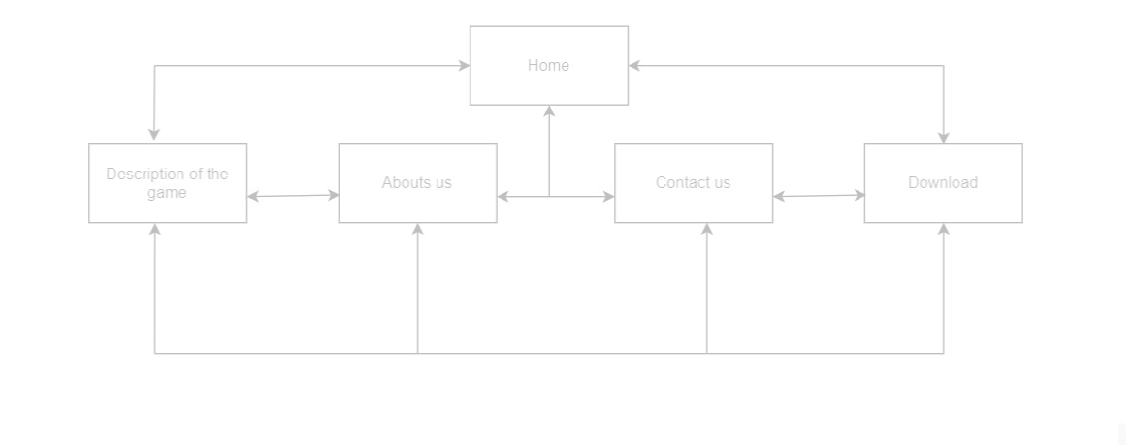

Slide 11
USED PROGRAMS

Slide 12












Slide 13
Let’s take a look at the site and the game

